Slide 1
Integration of Variable Energy Resources in PJM
Stu Bresler
Senior VP, Markets
PJM Interconnection
March 30, 2016

Slide 2
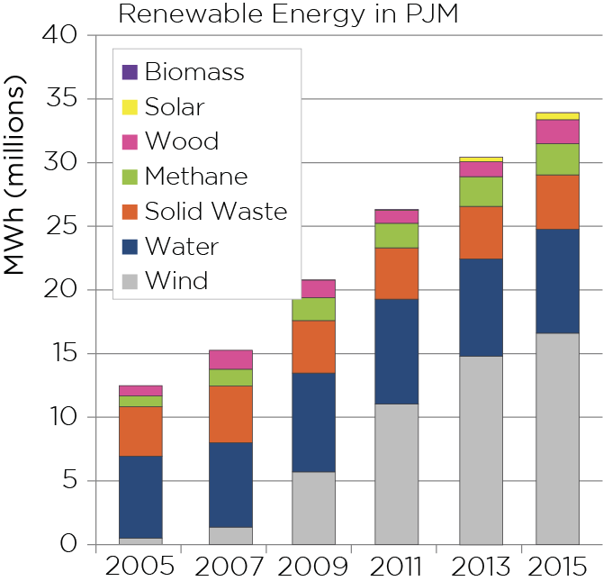
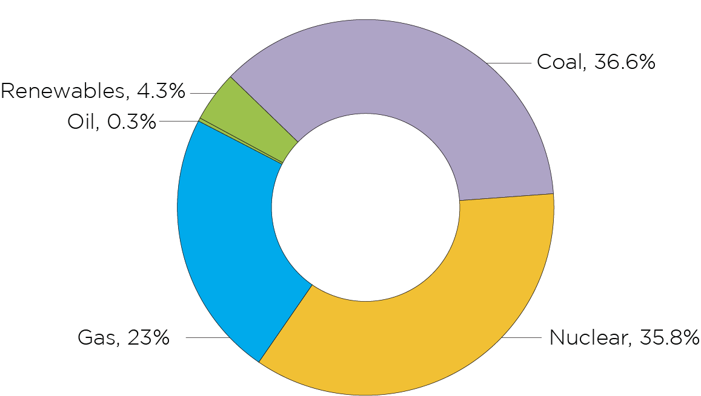
Percentage of Renewable Energy is Small but Growing
PJM Generation Mix - 2015

Slide 3
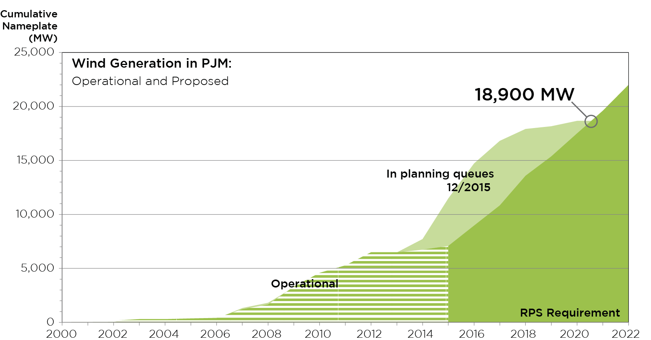
Proposed Wind Generation in PJM
Notes:
Schuyler updated 12/2016

Slide 4
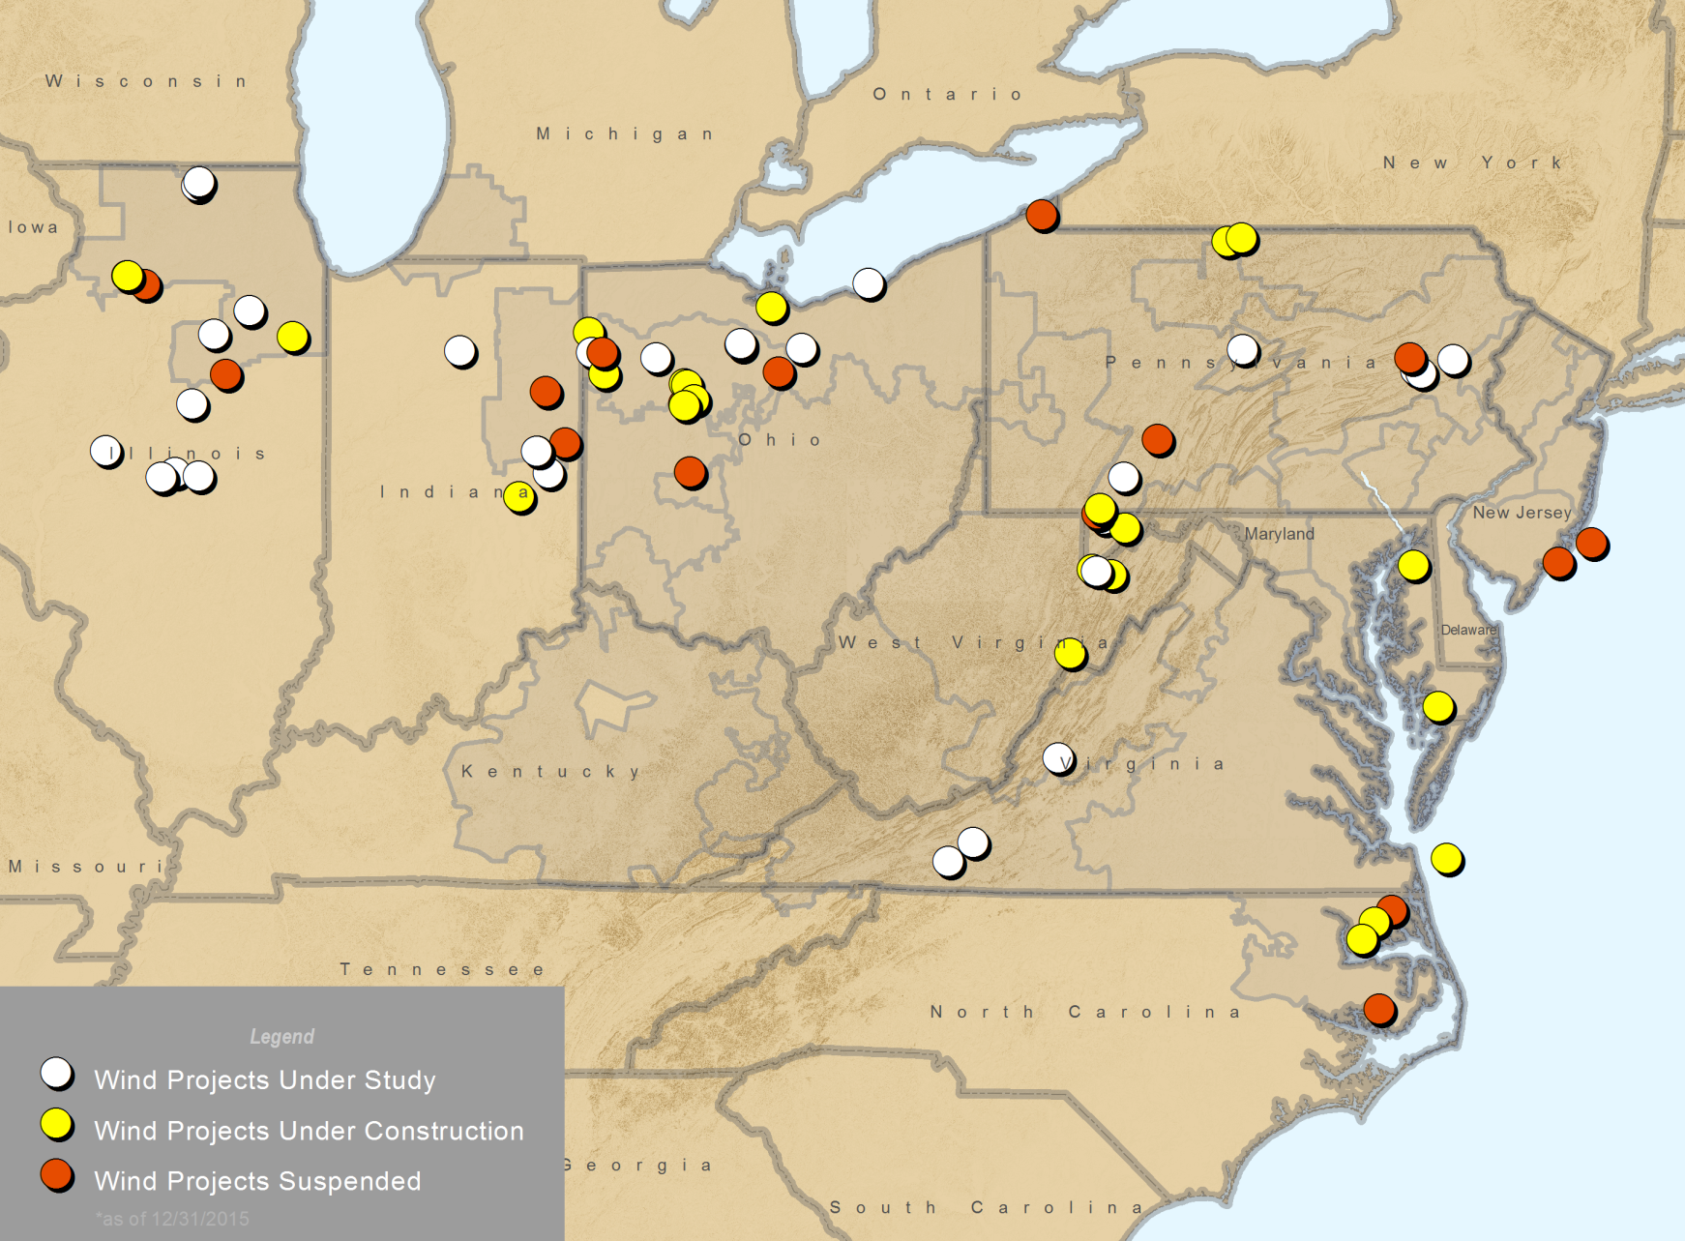
Wind Projects (Study, Construction & Suspended)

Slide 5
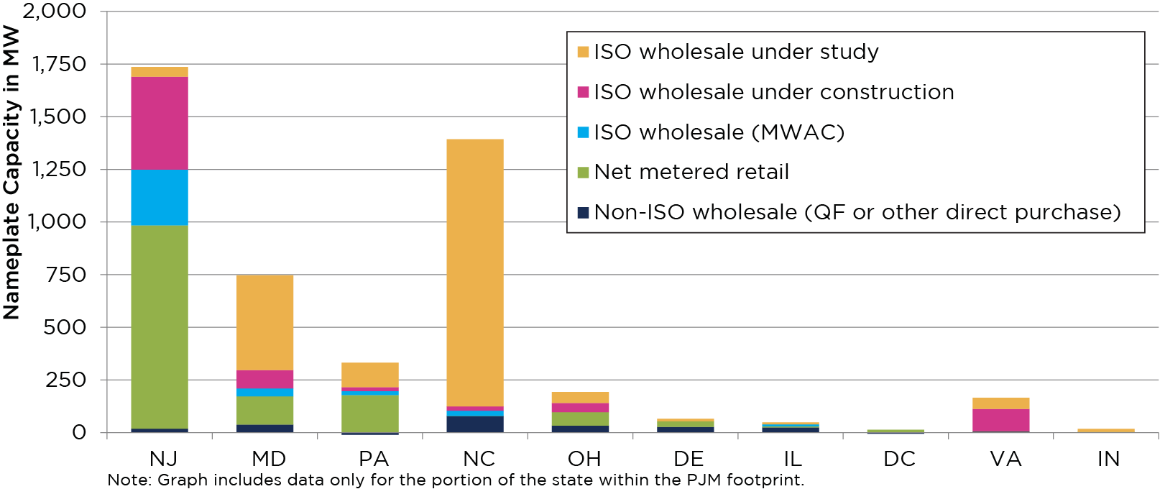
Solar Capacity in PJM by State

Slide 6
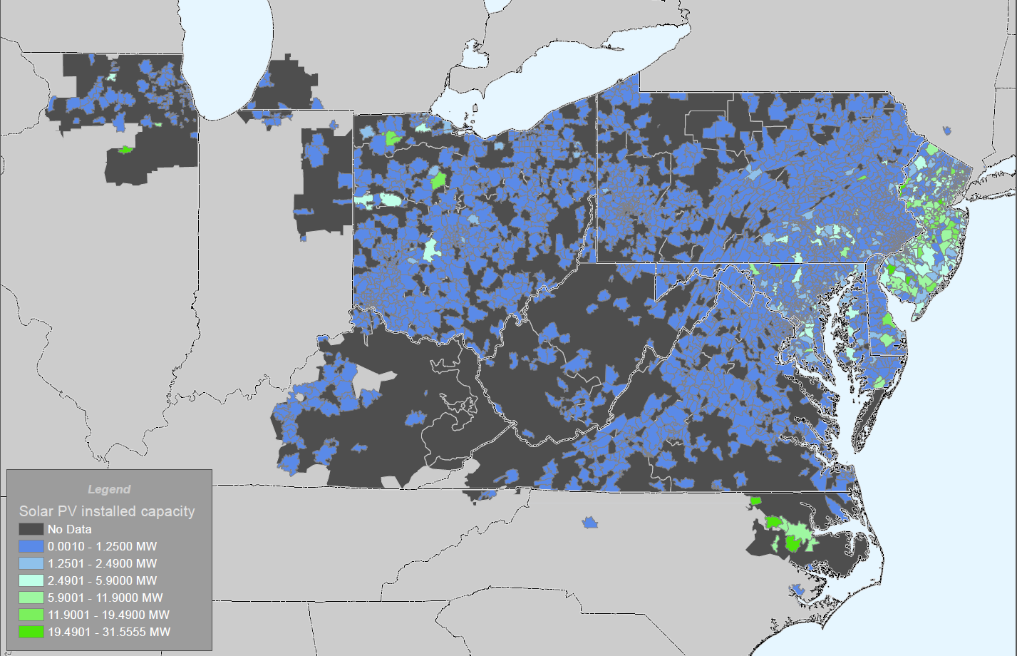
Solar PV in PJM
Notes:
Work to date: Full-scale evaluation of solar PV impact to PJM, including economic modeling (next slide)
Thanks to GATS, our visibility into BTM solar is good, but static. Advancing our visibility by forecasting generation output is the next step, and we’re pursuing a solar forecasting tool as we speak through a recently issued RFP. Operational in the control room in 2016 (?)

Slide 7
PJM Demand Response has captured much existing DER
DER includes distributed generation and storage. Excludes resources in state regions outside of PJM.

Slide 8
Impact of Increasing Wind Penetration
Impacts of wind power variability and uncertainty.
Minute-to-Minute
Additional generation needed to provide regulation
Intra-Hour
Conventional generators must adjust output
Day Ahead
Forecast errors cause over- or under-scheduling

Slide 9
Impact of Increasing VER Penetration
Regional markets reduce Variable Energy Resource integration costs
Characteristic | Impact to Integration Cost
Larger balancing areas | Reduces overall increase in variability Less regulation and ramping service required
Faster markets, i.e., shorter scheduling intervals (5-15 minutes) | Less regulation required to accommodate intra-hour variations
Larger geographic area | Increases weather diversity and reduces overall variability
Centralized wind power forecasting | Cost-effective approach to reduce scheduling impacts
Regional / Interregional Transmission Planning | Cost-effective upgrades to ensure grid reliability and mitigate congestion

Slide 10
Consequences of Continuing Solar Deployment
IHS forecasts for cumulative solar:
 | 2015 | 2030
BTM | 2 GW | 7.5 GW
Utility | 0.6 GW | 5 GW
Source: IHS. GWac. Excludes partial PJM states except 20% of NC and 50% of IL.
Stakeholder | Impact in 2030 | BTM Solar | Utility Solar
PJM Operations | New net load curve, shifted peaks | ✓ | ✓
PJM Ops + Planning | Wide-scale solar trip event contingency | ✓
PJM Markets | Impact on capacity prices. Possible reduction in LMP | ✓ | ✓
PJM Finance | PJM stated rates revenue reduced by ~$3 million | ✓
Members | Reduced energy sales → increased rates | ✓
States | Shifting policy drivers | ✓
Notes:
Explosive growth scenario means impact is higher, sooner, and grows faster.
Near-full solar eclipse near noon is another contingency consideration, though none are expected through 2030 in PJM.

Slide 11
PJM Initiatives to Address Impacts
Energy Markets / Operations
Implemented a centralized wind power forecast service.
Implemented changes to improve wind resource dispatch / control.
Demand Response / Price Responsive Demand improves operational flexibility
Frequency Regulation – incents better performing resources (like storage)
Interchange Scheduling – compliant with FERC Order 764 (15-minute intervals)
Transmission Planning
Light load criteria implemented to improve grid reliability
Expansion planning considers public policy impacts (i.e., RPS)
Grid interconnection – enhanced standards for new inverter-based resources (wind and solar)
Evaluating Potential Grid Impacts
PJM Renewable Integration Study (PRIS) - assessed grid impacts
Advanced Technology Research Program (ATRP)
Pilot programs to evaluate new technologies and remove barriers to participation in PJM markets and operations.

Slide 12
The Future of DR is DER
Evolving the PJM Demand Response Model
Inclusive of net-injection resources (storage, microgrids)
Better coordination with distribution system operator
Smart Inverters
Grid codes that enhance reliability and resiliency
New control architectures
Independent Distribution System Operations
Optimized planning and control (D-LMP?)
Tighter alignment of wholesale and retail pricing for services
Competitive environment for distribution-level services

